Slide 1
Field Effect Transistors

Slide 2
Transistor problems
Power density increased
Device variability
Reliability
Complexity
Leakage
Power dissipation limits device density
Transistor will operate near ultimate limits of size and quality – eventually, no transistor can be fundamentally better
◄

Slide 3
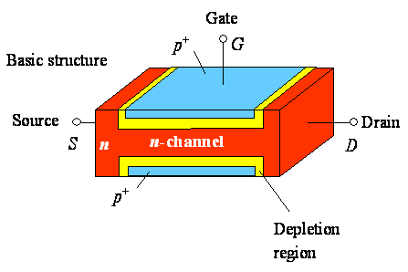
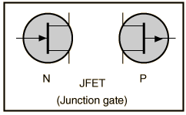
Junction FETs (JFETs)
A piece of semiconductor material which constitutes a channel
Conducting semiconductor channel between two ohmic contacts – source & drain
The Symbol

Slide 4
n type bar acts as a simple semiconductor resistor
Electrons flow from Source to drain if an electric field is applied between them
Only one carrier – electrons (for n-channel) or holes (for p channel) - unipolar
Depletion region exists for p-n junctions
Due to depletion region, the conduction portion of channel constricts
Channel thickness is dependent on both V_{DS} and V_{GS}

Slide 5
Electrons flow from source to Drain
Current I_{D} flows through channel
For a fixed V_{DS}, I_{D} is also dependent on V_{GS} as it increases or decreases the reverse bias
Mechanism of current is the effect of field produced by V_{DS} and V_{GS} (FIELD EFFECT TRANSISTOR)
I_{D}
V_{GS}
V_{DS}

Slide 6
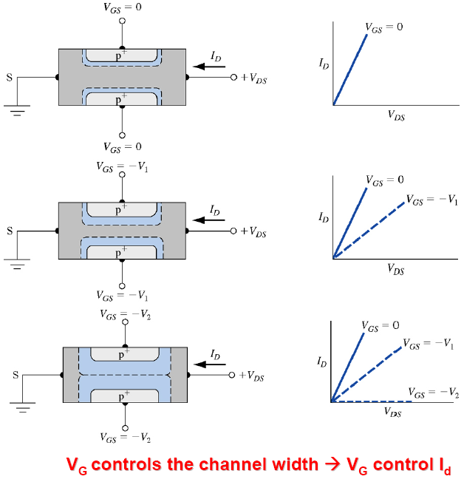
I-V characteristics
More V_{GS} (more –ve) implies
- More reverse bias
- More depletion region
- Less channel width
- Less current I_{D}

Slide 7
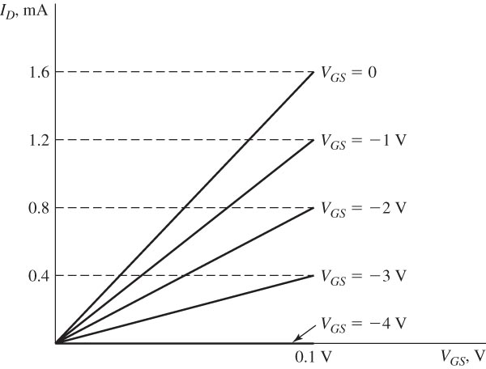
Characteristics in linear portion of the ohmic region.
V_{DS}
Current I_{D} flows through channel following Ohm’s law

Slide 8
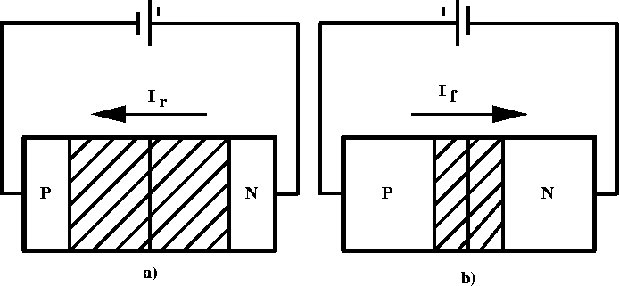
Junction FETs (JFETs)
Length of Depletion region depends on the reverse bias voltage
Length of Depletion region depends on the voltage difference between channel and gate
The voltage at channel is dependent on position , as ohmic drop varies along the channel
Thus the constriction of conduction channel is not uniform

Slide 9
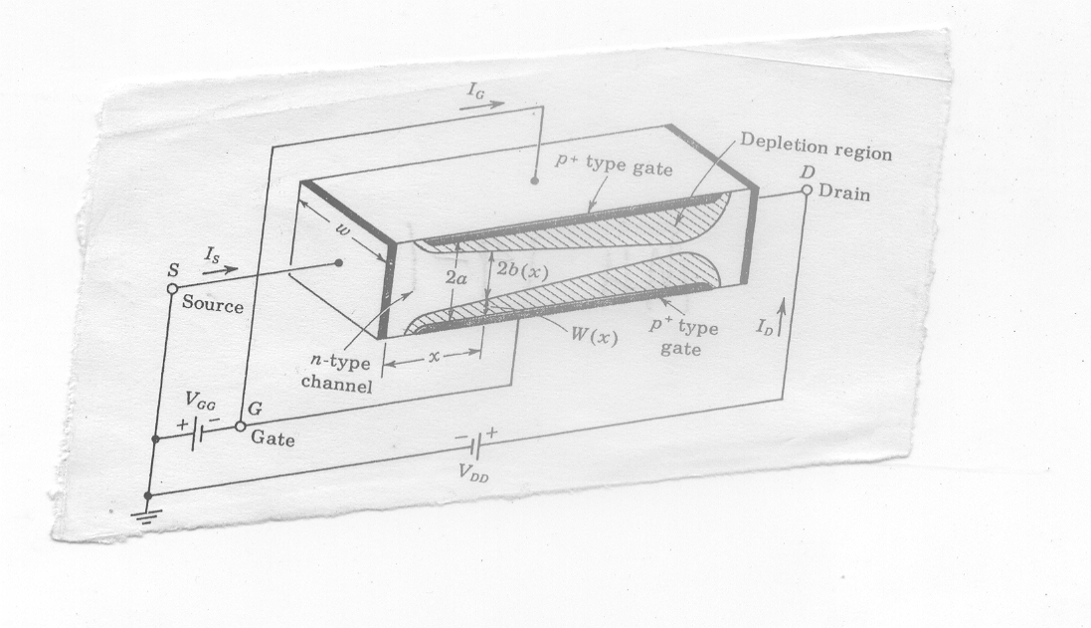
The structure of a n-Channel FET
The constriction is more pronounced at distance farther from the source
The constriction is dependent on the current (which is dependent on both V_{GS} and V_{DS})

Slide 10
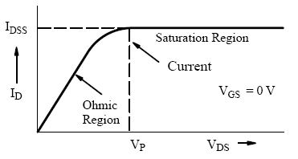
The structure of a n-Channel FET
I_{D}
V_{GS}
V_{DS}
For a fixed V_{GS}, if increase V_{DS} more and more, I_{D} will increase, - and channel will constrict more and more
Eventually I_{D} is reached to such a level (I_{DSS}) such that the channel is pinched off
At this point I_{D} begins to level off and approach a constant value
pinch-off voltage, V_{P} , which is the value of V_{DS} at which the maximum I_{DSS} flows
Note: channel never completely closes as that reduces I_{D} to zero

Slide 11
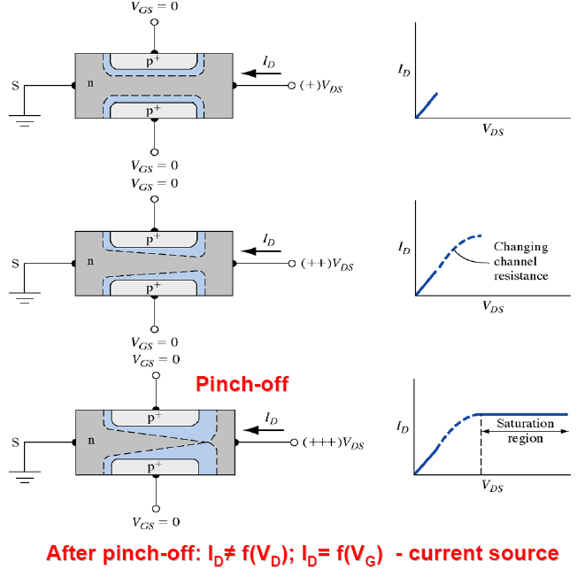
I-V characteristics

Slide 12
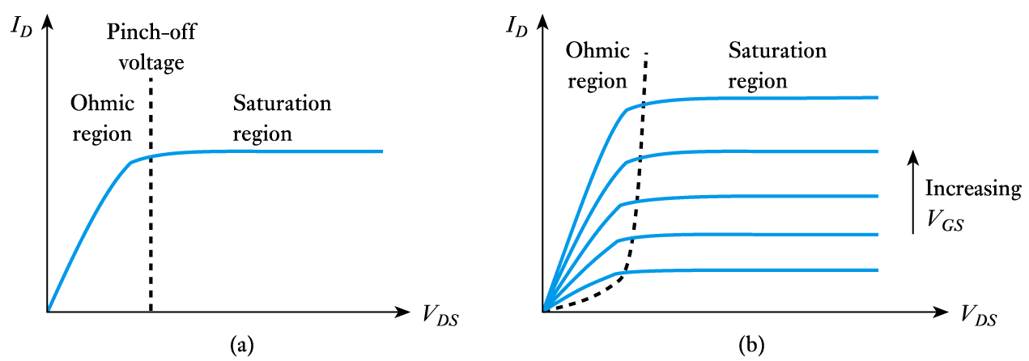
FET output characteristics

Slide 13
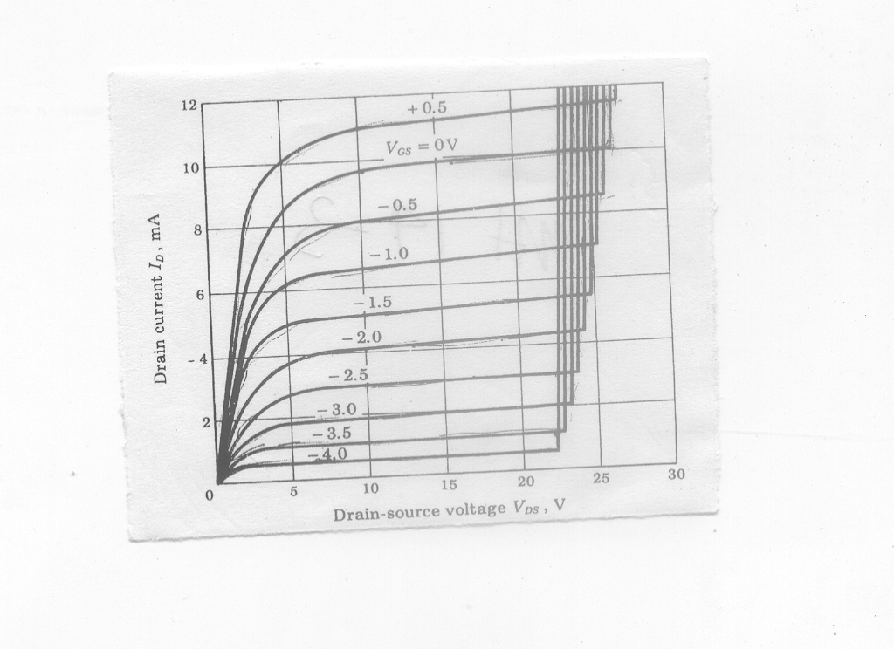
Increasing more and more reverse bias (V_{DS} ) causes the junctions to breakdown
If V_{GS} is more negative, the breakdown occurs at early V_{DS}

Slide 14
More practical n-channel JFET
Difficult in diffusing impurities into both sides of a semiconductor
(a)
Single-ended-geometry junction FET
Diffusion is from one side only
N-type channel is epitaxially grown in p-type substrate

Slide 15
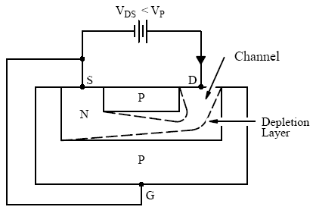
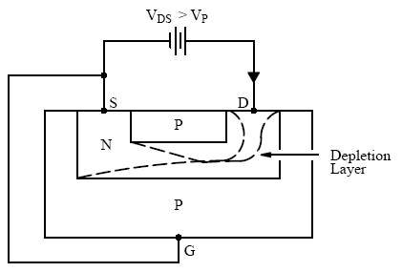
Depletion layer thickness is changing with V_{DS}

Slide 16
Bipolar Junction Transistor versus Field Effect Transistor
FET is unipolar. – there is only majority carrier. BJT is bipolar (there are both majority and minority carrier)
No offset voltage at zero drain current
High input resistance
Has thermal stability
Less noisy
Relatively immune to radiation
Simpler to fabricate and takes less space in integrated form

